Slide 1
CSE 308 Software Engineering and Information System Design Sessional
Agricultural Information System
Group No: 04
Group Members:1005078
1005079
1005083
1005086
1005087
Collaboration diagram & Class diagram

Slide 2
Subsystems
Farmer Account Management
Agro-based Info
Experts’ Solution
Weather Update

Slide 3
Farmer Account Management

Slide 4
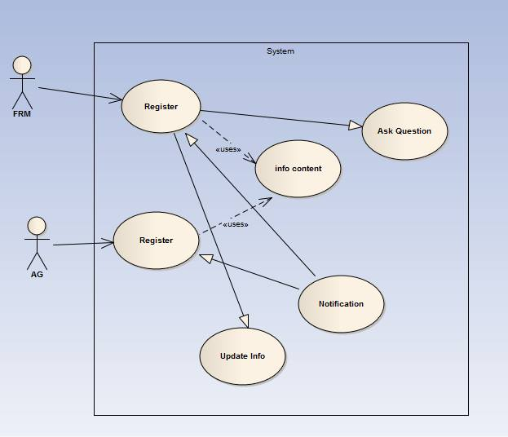

Slide 5
Farmer registration: Noun Identification
Actor Action (Farmer, Agent) | System Response
1.none | 2. Show registration Form
3. Submit registration form. | 4. Send registration form to administrator
5. Administrator accepts or rejects the Registration request. | 6. If accepts, then the system enrolls farmers info into database(farmers list and info). If rejects, then the system ignores it. By registering, each farmer have individual profile.
 | 7. Send acceptance/ decline message to Farmer

Slide 6
Farmer registration: Entity
FarmersInfoList
RegistrationInfo

Slide 7
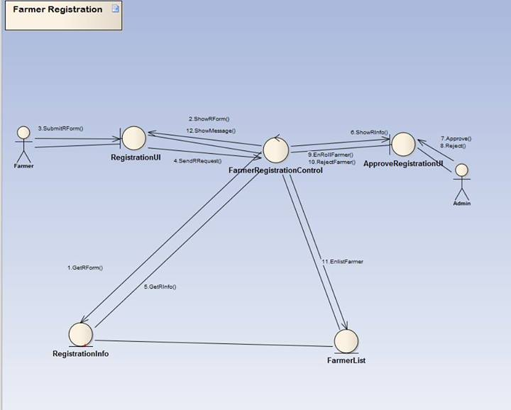
Farmer Registration : Collaboration Diagram

Slide 8
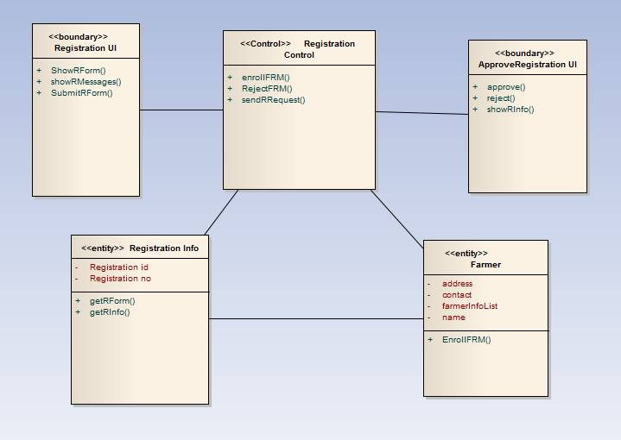
Farmer registration: Class Diagram

Slide 9
Agent registration: Noun Identification
Actor Action (Agent) | System Response
1.none | 2. Show registration Form
3. Submit registration form. | 4. Send registration form to administrator
5. Administrator accepts or rejects the Registration request. | 6. If accepts, then the system enrolls agents info into database(farmers list and under each AG and address info). If rejects, then the system ignores it. By registering, each agent have individual profile.
 | 7. Send acceptance/ decline message to Farmer

Slide 10
Agent Registration : Entity
AgentList
RegistrationInfo

Slide 11
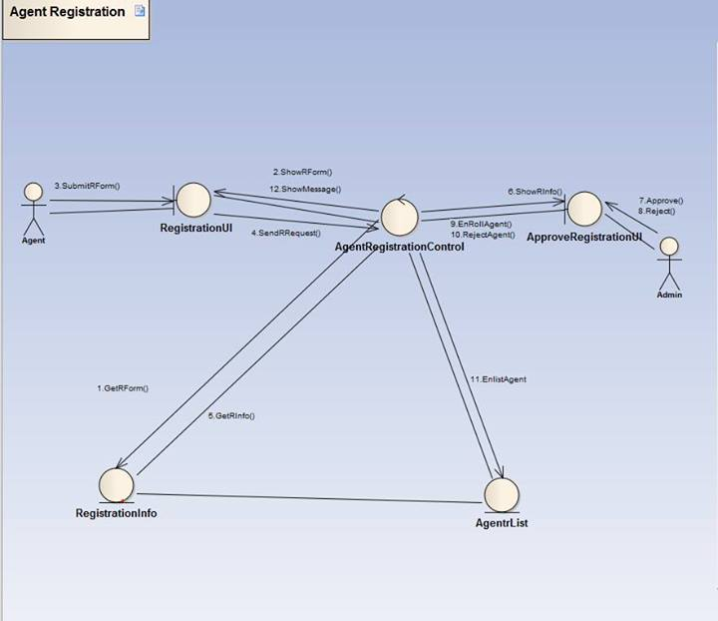
Agent Registration : Collaboration Diagram

Slide 12
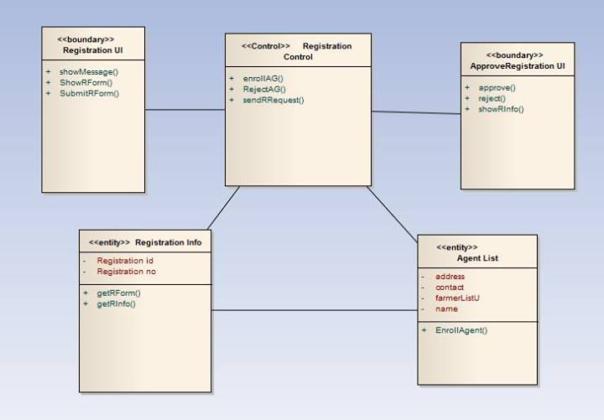
Agent Registration : Class Diagram

Slide 13
Farmer Info Update : Noun Identification
Actor Action (Farmer, Agent) | System Response
1.none | 2. Show profile and update form
3. Submit updates. | 4. Send updates to FarmersInfoList And show updated info.

Slide 14
Farmer Info Update : Entity
Farmer
FarmerAccount

Slide 15
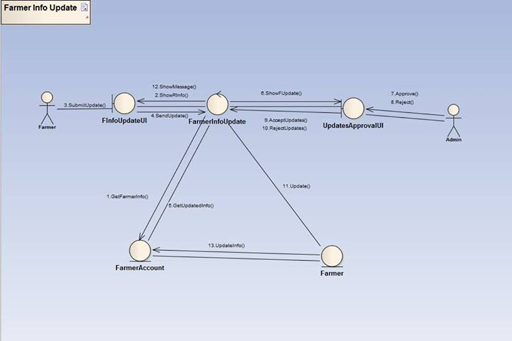
Farmer Info Update :
Collaboration Diagram

Slide 16
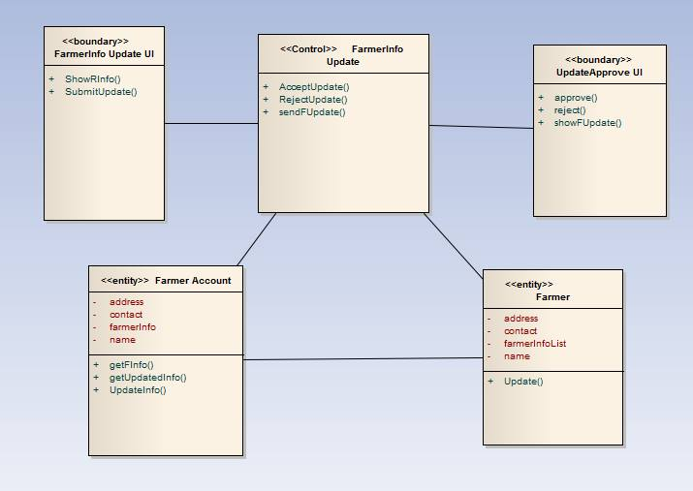
Farmer Info Update : Class Diagram

Slide 17
Agro Based Info

Slide 18
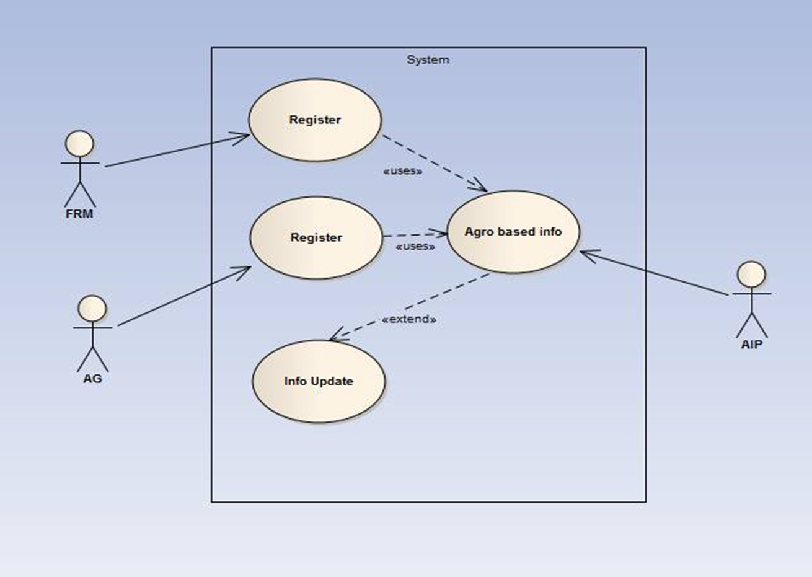

Slide 19
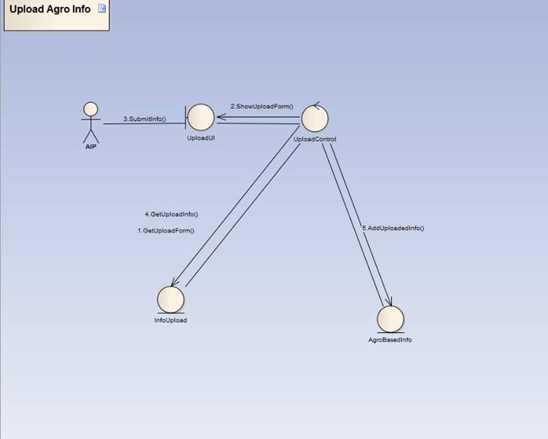
Upload Agro Info : Collaboration Diagram

Slide 20
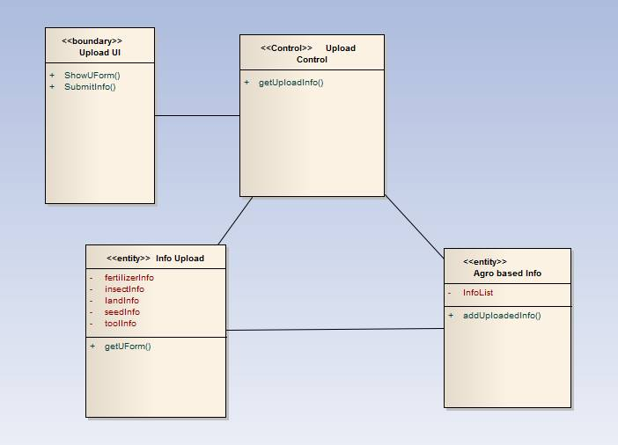
Upload agro Info: Class Diagram

Slide 21
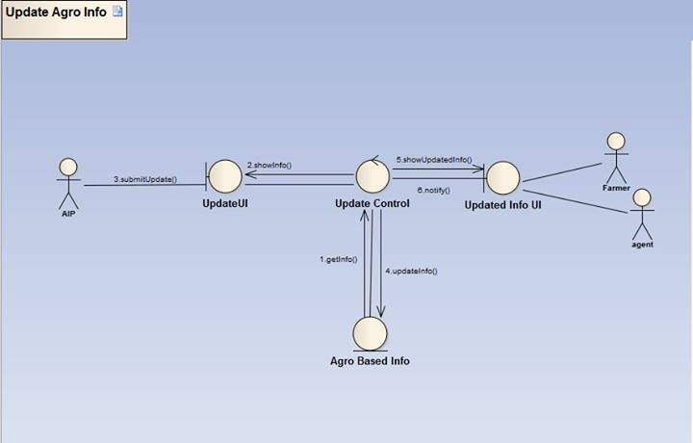
Update Agro Info : Collaboration Diagram

Slide 22
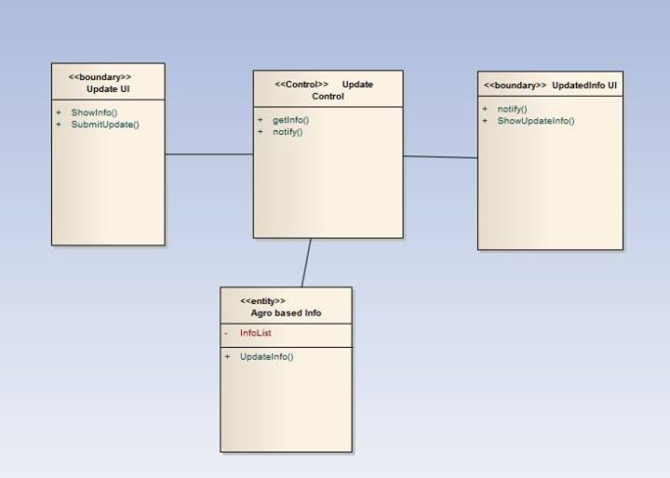
Update Agro Info : Class Diagram

Slide 23
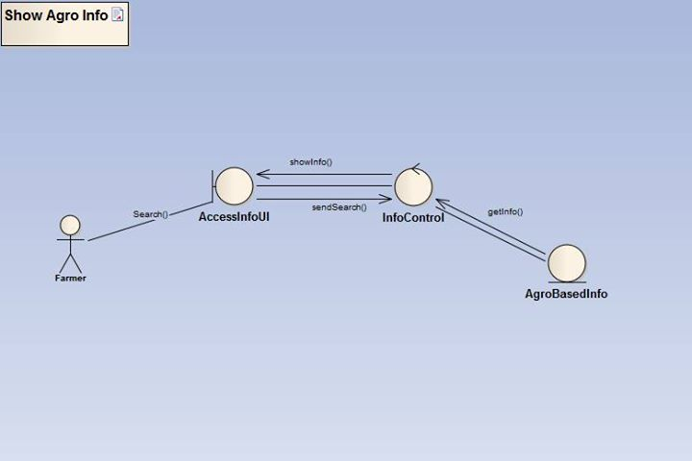
Access Info : Collaboration Diagram

Slide 24
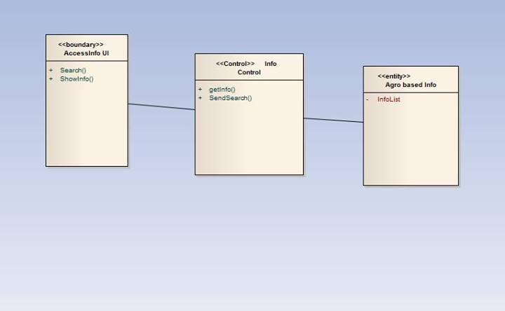
Access Agro Info :
Class Diagram

Slide 25
Experts Solution

Slide 26
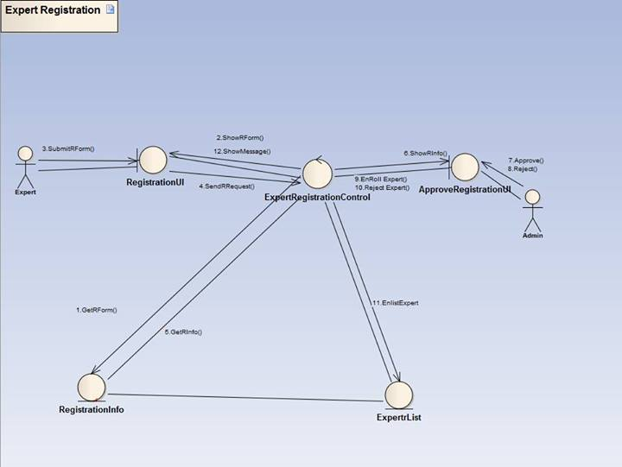
Experts Registration :
Collaboration Diagram

Slide 27
Form District Team :
Class Diagram

Slide 28
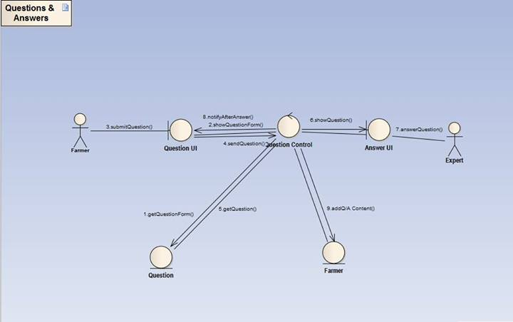
Question and Answer :
Collaboration Diagram

Slide 29
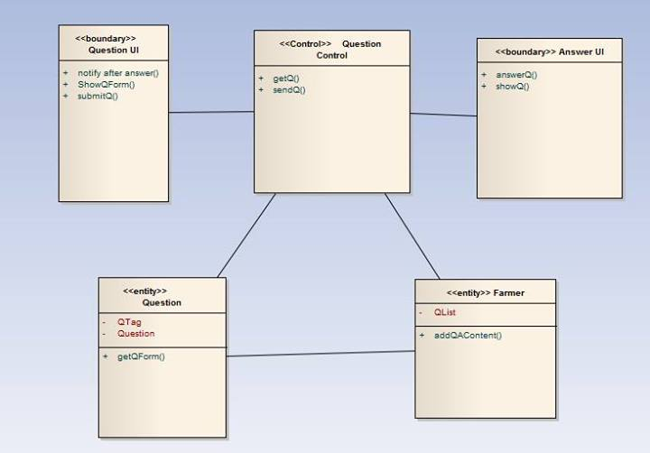
Form Divisional Team:
Class Diagram

Slide 30
Weather Update

Slide 31
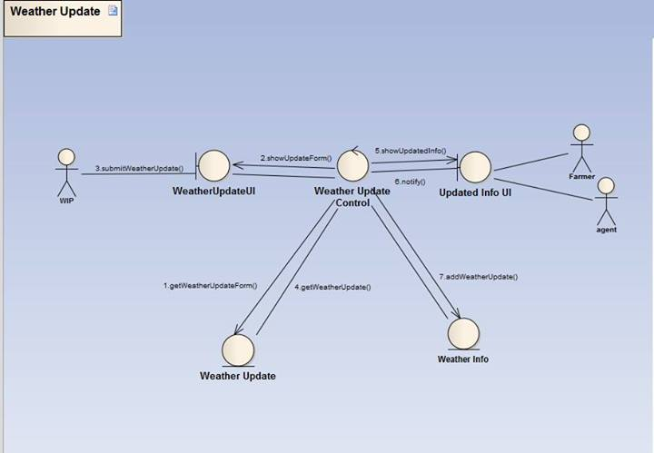
Weather Forecast and info :
Collaboration Diagram

Slide 32
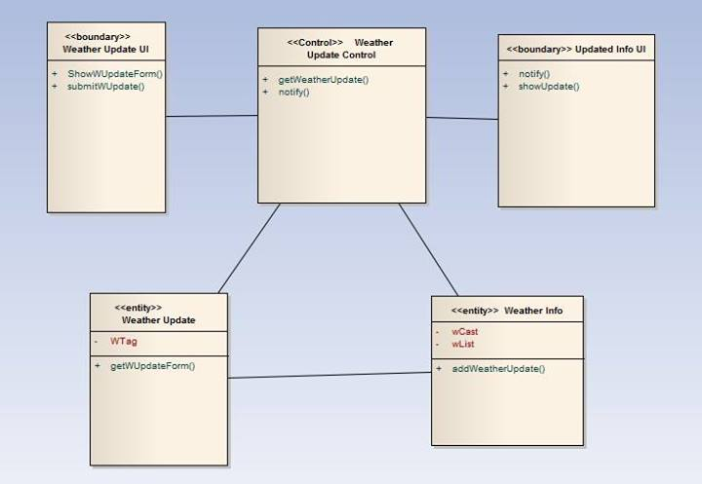
Weather Forecast :
Class Diagram

Slide 33
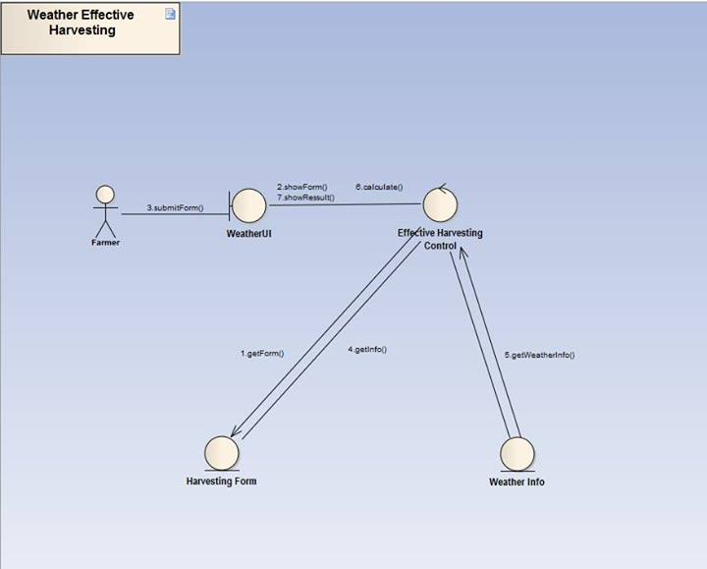
Weather Effective Harvesting :
Collaboration Diagram

Slide 34
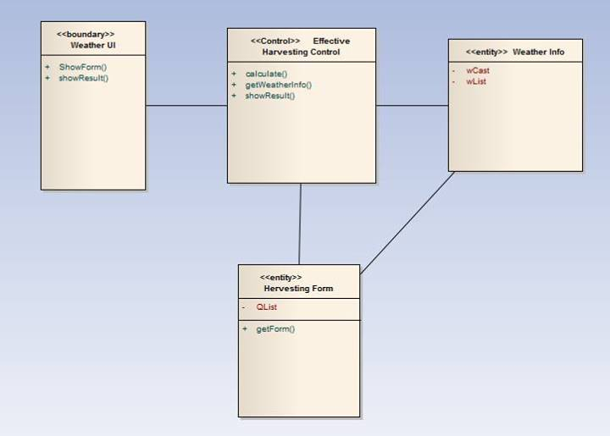
Weather Effective Harvesting : Class Diagram

Slide 35


